Slide 1

WATERFLL MODEL
Presented by..
Shiva Krishna
Santhosh Chandra
Varsha nihanth
Aparna
Archana
Anusha

Slide 2
SDLC Models
Sequential model
Incremental model

Slide 3
Sequential model
Waterfall model.
V-model.
Incremental model.
Spiral model
RAD(Rapid application development)
model.
Incremental model

Slide 4
Waterfall Model
It is also called as linear sequential model.
In this model whole application is developed in a sequential approach.
In this model each phase must be completed fully before the next phase begin.
Provides structure to inexperienced staff.

Slide 5
History of waterfall model
The first formal description of the waterfall model is often cited as a 1970 article by Winston W.Royce.
Royce presented this model as as an example of a flawed,non-working model.
It has been widely used for software projects ever since.

Slide 6
Where to use the
waterfall model
Requirements are very well known.
Product definition is stable.
Technology is understood.
New version of an existing product.

Slide 7
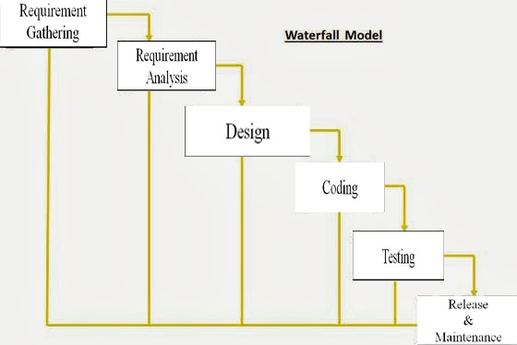
Waterfall model Diagram

Slide 8
Requirement
Gathering
In this phase business analyst will collect the requirements with an interaction of client and collected requirements will be documented.
In this phase system analyst will study the client requirements and prepare the system requirement specification.
Requirement
Analysis
In this phase design architecture is the responsible to decide architecture of an application in order to full-fill the client requirements .
Design
In this phase developers will write the program using programming languages or scripting languages in order to develop the application.
Coding
Initially developers will perform unit testing and integration testing using of white box testing, After that separate team will be perform system testing using black box testing
Testing
Release
&
Maintenance
After the testing client satisfied on work product then we deliver application to the customer to use at live environment. While using this application client identify can some defects in existing s/m then he will send to the CR to CCB .

Slide 9
ADVANTAGES
A waterfall model is easy to implementation.
It helps to find errors earlier
Easy to understand, easy to use.
Works well when quality is more important than cost or schedule
Documentation is produced at every stage of a waterfall model allowing people to understand what has been done.
Testing is done at every stage.

Slide 10
disadvantages
It is only suitable for the small size projects.
Constant testing of the design is needed.
If requirements may change the Waterfall model may not work.
Difficult to estimate time and cost for each stage of the development process.
Adjust scope during the life cycle can kill a project.
High amount of risk and uncertainty.
This model is not suitable to handle dynamic changes in the requirements

Slide 11

ANY QUERIES

Slide 12



