Slide 1

Water Fall Model
Prepared by
Visani bhargav r
090210116031
6Th i.t

Slide 2
Index
History of water fall model.
Features of water fall model.
Phase of water fall model.
Brief description of phases.
Advantages.
Disadvantages.

Slide 3
History of Water Fall Model
The first formal description of the waterfall model is often cited as a 1970 article by Winston W. Royce
Royce did not use the term "waterfall" in this article.
Royce presented this model as an example of a flawed, non-working model.

Slide 4
Features of Water Fall Model
A Water Fall Model is easy to flow.
It can be implemented for any size of project.
Every stage has to be done separately at the right time so you cannot jump stages.
Documentation is produced at every stage of a waterfall model allowing people to understand what has been done.
Testing is done at every stage.

Slide 5
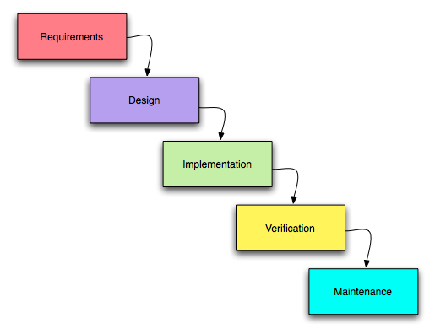
Water Fall Model

Slide 6
Phases of Water Fall Model
Waterfall model has 5 different phases, Which are following.
1)Requirement gathering and Analysis.
2)Design.
3)Coding.
4)Testing.
5)Maintenance.

Slide 7
Brief Description of Phase
Requirement gathering and Analysis.
This is the first phase of waterfall model which includes a meeting with the customer to understand his requirements.
This is the most crucial phase as any misinterpretation at this stage may give rise to validation issues later.
The software definition must be detailed and accurate with no ambiguities.
It is very important to understand the customer requirements and expectations so that the end product meets his specifications.

Slide 8
Brief Description of Phase
Requirement gathering and Analysis phase the basic requirements of the system must be understood by software engineer, who is also called ANALYST.
All this requirements are then well documented and discussed further with the customer for reviewing.

Slide 9

Brief Description of Phase

Slide 10
Brief Description of Phase
2)Design.
The customer requirements are broken down into logical modules for the ease of implementation. Hardware and software requirements for every module are Identified and designed accordingly.
Also the inter relation between the various logical modules is established at this stage. Algorithms and diagrams defining the scope and objective of each logical model are developed.
In short, this phase lays a fundamental for actual programming and implementation

Slide 11
Brief Description of Phase
It is a intermediate step between requirements analysis and coding.
Design focuses on program attribute such as-
1) Data Structure.
2) Software Architecture.
3) Algorithm Details
etc…….
The requirements are translated in some easy to represent form using which coding can be done effectively and efficiently.
The desing needs to be documented for further use.

Slide 12

Brief Description of Phase

Slide 13
Brief Description of Phase
3)Coding.
Coding is a step in which design is translated into machine-readable form.
If design is done in sufficient detail then coding can be done effectively.
Programs are created in this phase.
In this phase all software divided into small module then after doing coding for that small module rather than do coding whole software.
According to design programmers do code and make class and structure of whole software.

Slide 14

Brief Description of Phase

Slide 15
Brief Description of Phase
4)Testing.
In this stage, both individual components and the integrated whole are
methodically verified to ensure that they are error-free and fully meet the requirements
outlined in the first step.
In this phase testing whole software into two parts 1) HARDWARE & 2) SOFTWARE.
Type of testing is 2-types
1) Inside test.
2) Outside test.

Slide 16
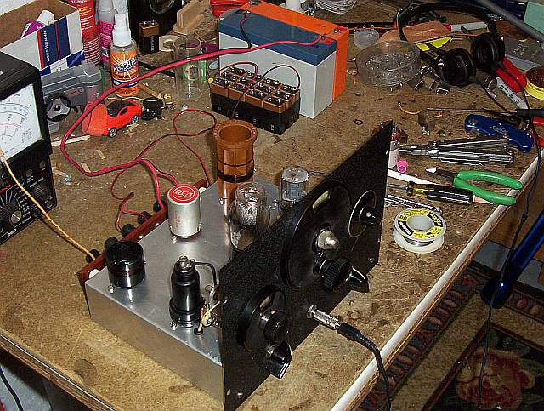
Brief Description of Phase

Slide 17
Brief Description of Phase
5)Maintenance.
This is the final phase of the waterfall model, in which the completed software product is handed over to the client after alpha, beta testing.
After the software has been deployed on the client site, it is the duty of the software development team to undertake routine maintenance activities by visiting the client site.
If the customer suggests changes or enhancements the software process has to be followed all over again right from the first phase i.e requirement analysis.

Slide 18
Brief Description of Phase
The usually the longest stage of the software. In this phase the software is updated to:
a) Meet the changing customer needs
b) Adapted to accommodate changes in the external environment
c) Correct errors and oversights previously undetected in the testing phases
d) Enhancing the efficiency of the software
Observe that feed back loops allow for corrections to be incorporated into the model.

Slide 19
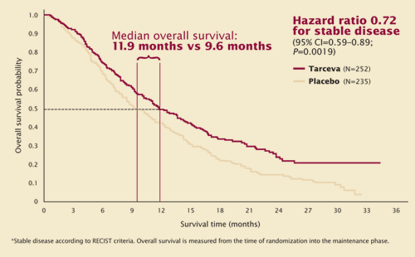
Brief Description of Phase

Slide 20
Advantages of water fall model
The water fall model is easy to implementation.
For implementation of small systems water fall model is use full.
The project requires the fulfillment of one phase, before proceeding to the next.
It is easier to develop various software through this method in short span of time.

Slide 21
Disadvantages of water fall model
The requirement analysis is done initially and sometimes it is not possible to state all the requirement explicitly in the beginning.
The customer can see working model of the project only at the end.
If we want to go backtrack then it is not possible in this model.
It is difficult to follow the sequential flow in software development process.

Slide 22
QUERRIES
?

Slide 23
Thank you

