Slide 1
TYPES OF INFORMATION SYSTEMS

Slide 2
TYPES OF INFORMATION SYSTEMS
Transaction processing systems (TPS)
Management information system (MIS)and
Decision support systems (DSS)
Executive support system (ESS) for senior management

Slide 3
1) Transaction processing system
Transaction processing system is a type of information system.
TPSs collect, store, modify and retrieve the transactions of an organization.
A Transaction is an event that generates or modifies data that is eventually stored an information system.
E.g: Order entry system, cheque processing systems, accounts receivables systems, payroll systems and ticket reservation systems
These systems help any company to conduct operations and keep track of its activities.

Slide 4
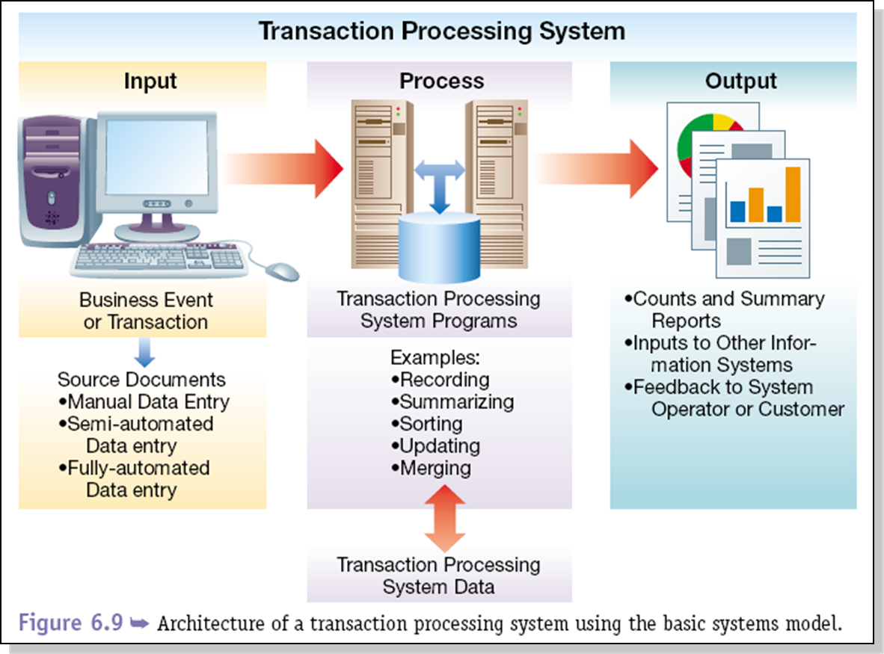

Slide 5
A PAYROLL TPS
To general ledger
EMPLOYEE DATA
Payroll
System
Employee /file
database
Management
reports
Employee number
Address
Pa rate
Gross pay
Federal tax
Medicare
State tax
Net pay
To government
agencies
Employee paychecks
Online
queries

Slide 6
TPS CHARACTERISTICS
A TPS records internal and external transactions for a company. It is a repository of data that is frequently accessed by other systems
A TPS performs routine , repetitive tasks .It is mostly used by lower level managers to make operational decisions
Transactions can be recorded in batch mode or online. In batch mode the files are updated periodically. In online mode , each transaction is recorded as it occurs
There are six steps in processing a transaction:
  data entry ,
  data validation ,
  data processing and
  revalidation ,
  storage – output generation and
  query support

Slide 7
Objectives of TPS
Process data generated by and about transactions
Maintain a high degree of accuracy and integrity
Avoid processing fraudulent transactions
Produce timely user responses and reports
Increase labor efficiency
Help improve customer service
Help build and maintain customer loyalty
Achieve competitive advantage

Slide 8
TYPES OF TPS
Online system:
  it involves a direct connection between the operator and TPS program , they provide immediate result eg . An order arrive by telephone call it is processed at that moment and results are produced
Batch processing:
  it is the second type of TPS ,where transactions are grouped together and processed as a unit
  for eg: a cheque proccesing system in a bank all the cheque received in a particular day are grouped together. They are then sorted by the account no and processed in a batch

Slide 9
More Examples
Batch transaction processing:
  Cheque clearance :written order asking bank to pay money to a person
  Bill generation : an invoice for general services provided to the customers
  credit card sales transaction
Examples of real time transaction processing:
  reservation systems; set aside service/product for future use
  point -of-sale (POS) terminals ;sells goods/services
  library loan system ; keeps track of items borrowed from library

Slide 10
Difference between real time and Batch
Real time:
  each transaction is unique ; transactions are standlone; requires master file to be available more often for updating; fewer errors-transaction data is validated and entered immediately; infrequent errors may occur; not practical to shut down the whole system
Batch:
  each transaction pat of a group; database not accessible all of the time; more errors; data is organized and stored before master file is updated -errors can occur during these steps; easier to maintain than real- time.

Slide 11
2) MIS
Designates a specific category of information systems serving middle management.
Provides middle managers with reports on organization’s current performance.
Information thus obtained is used to monitor and control and business and predict future

Slide 12
Characteristics of MIS
MIS is an integrative system
MIS is Sub System concept
Provides relevant information to management
MIS is flexible
Enhances productivity
Is a coordinated system
Feedback system

Slide 13
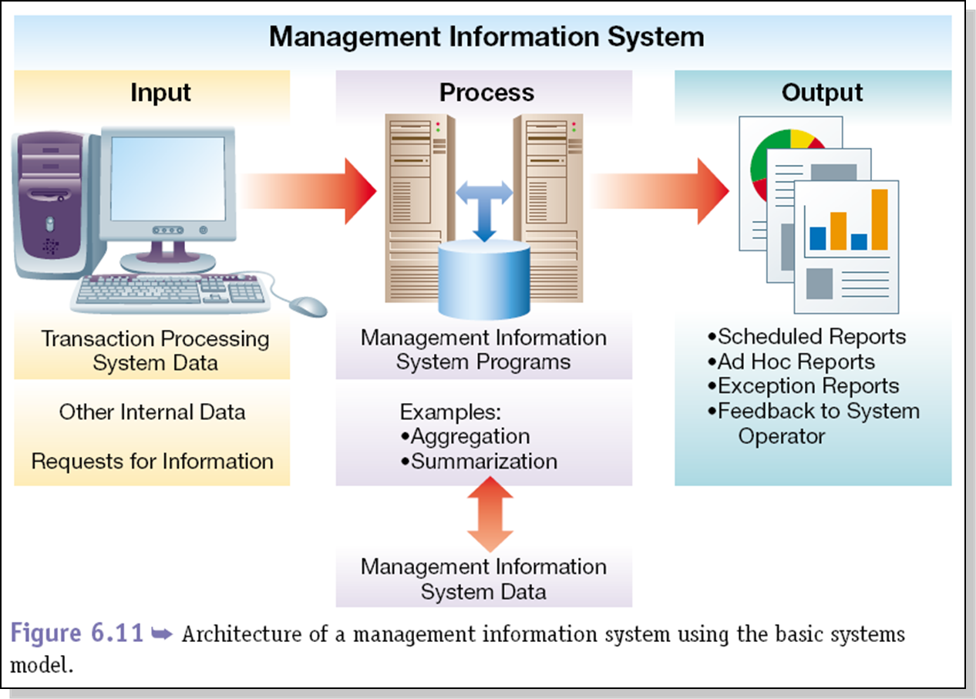

Slide 14
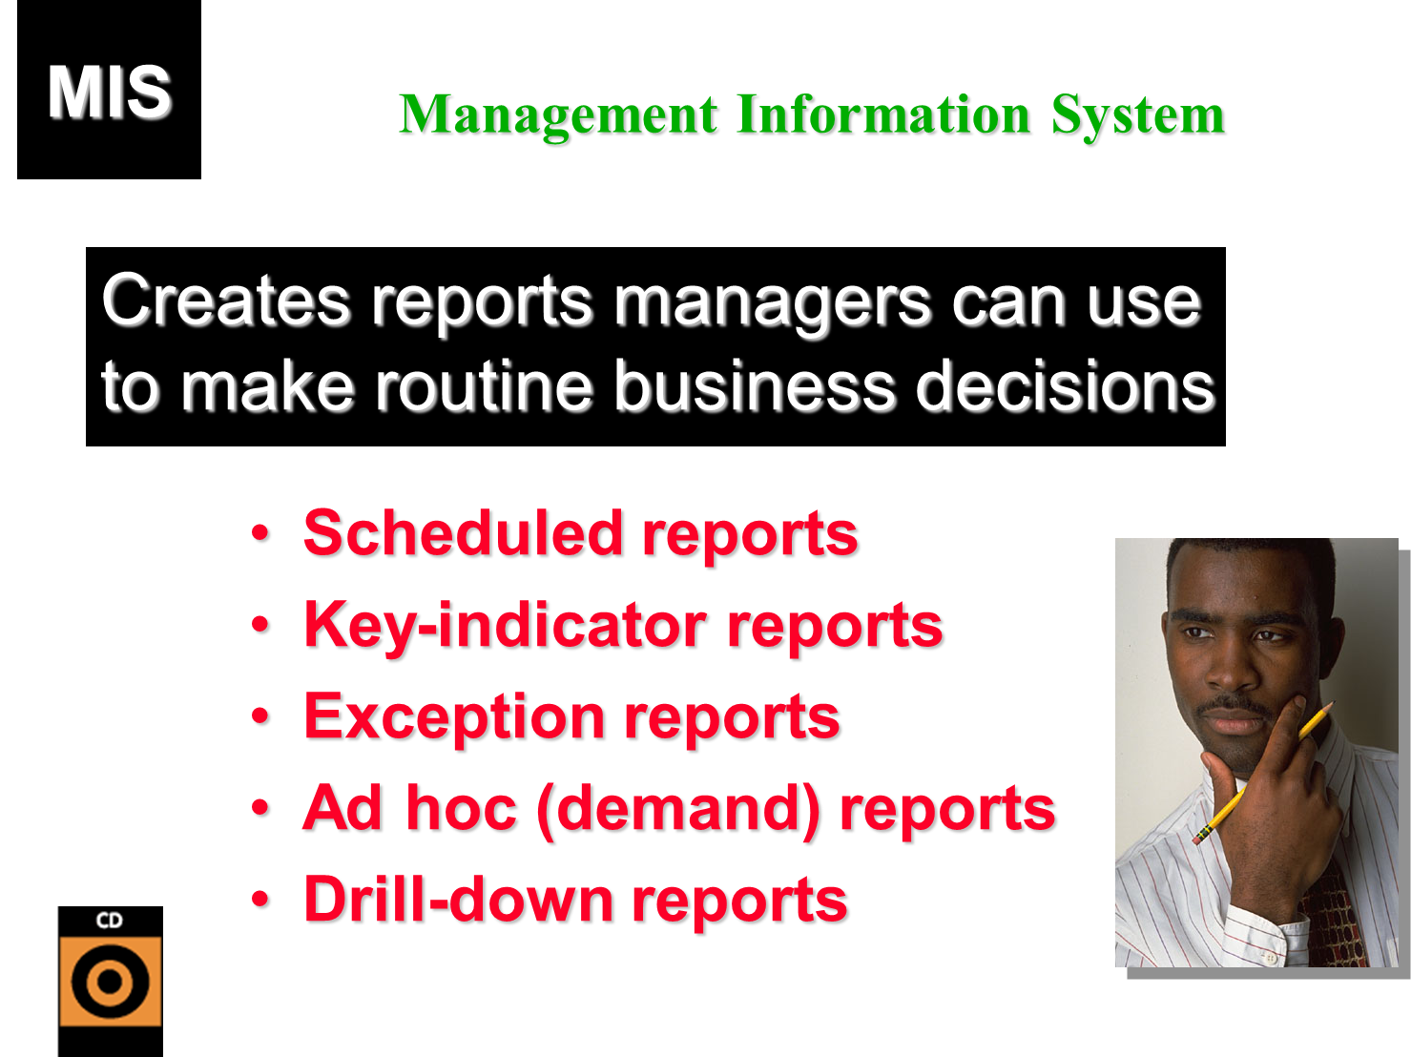

Slide 15
MIS
TPS
MIS
Order file
Order
Processing system
Sales
data
Production
Master
file
Materials
Resource
Planning system
MIS
Unit
Product
Cost data
reports
Product change data
managers
Accounting
file
General
Ledger system
Expense data

Slide 16
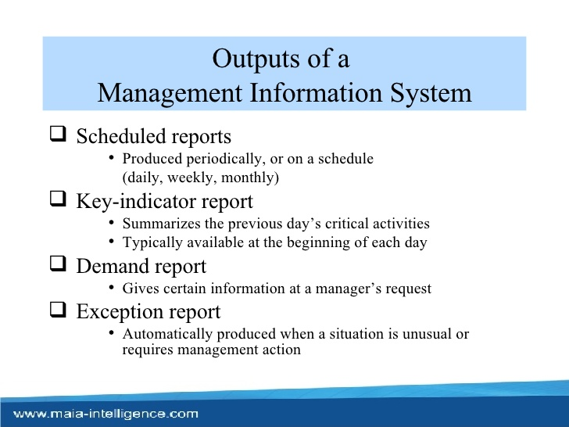

Slide 17
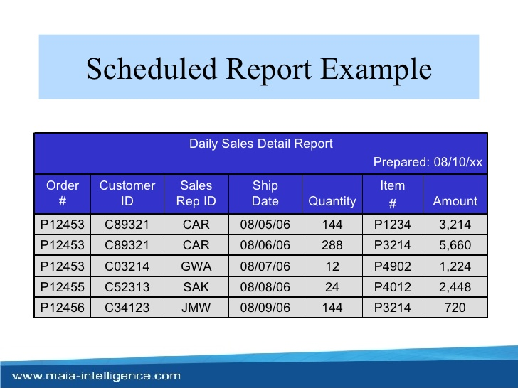

Slide 18
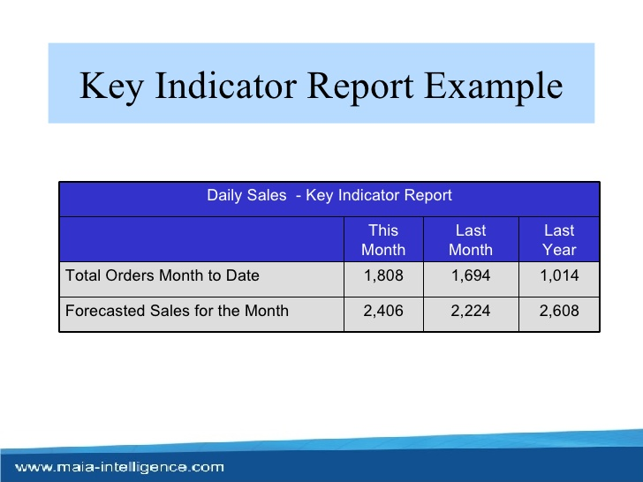

Slide 19
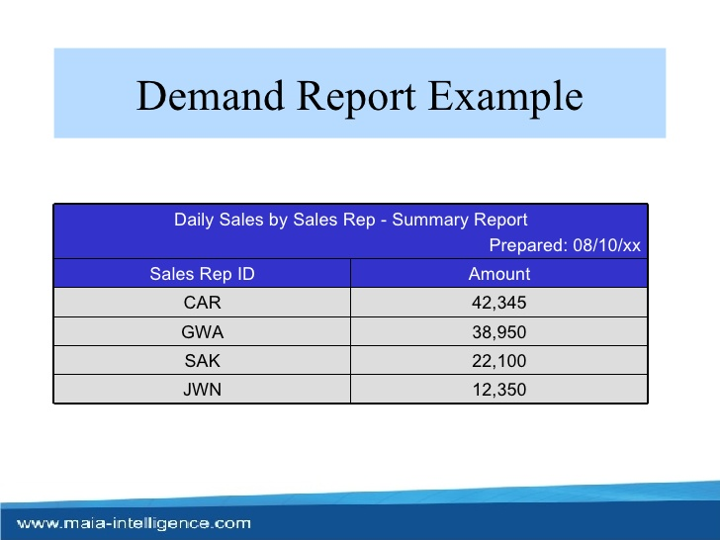

Slide 20
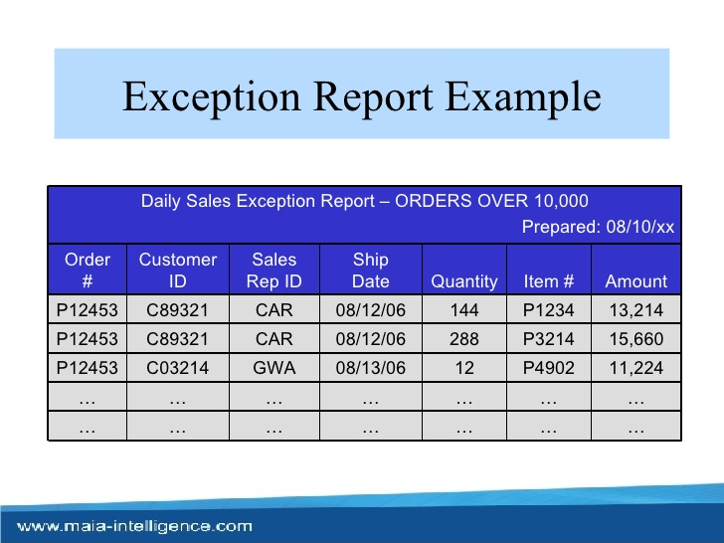

Slide 21
3)Decision Support System
A decision support system (DSS) is a computer program application that analyzes business data and presents it so that users can make business decisions more easily.
It is an "informational application" (to distinguish it from an "operational application" that collects the data in the course of normal business operation).
Typical information that a decision support application might gather and present would be:
  Comparative sales figures between one week and the next
  Projected revenue figures based on new product sales assumptions
  The consequences of different decision alternatives, given past experience in a context that is described
  A decision support system may present information graphically and may include an expert system or artificial intelligence (AI). It may be aimed at business executives or some other group of Knowledge workers

Slide 22
Characteristics of Decision support system
Provides rapid access to information
Handles large amount of data from different sources
Provides report and presentation flexibility
Offer both textual and graphical orientation
Support drill down analysis
Perform complex ,sophisticated analysis aqnd comparisons using advanced s/w

Slide 23
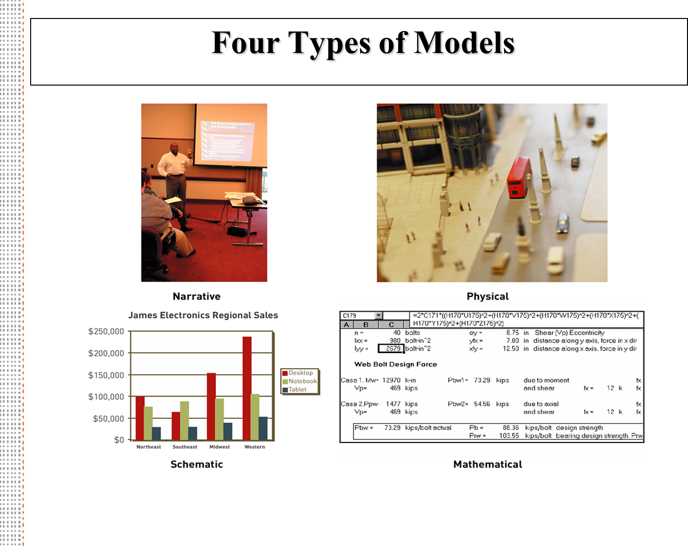

Slide 24
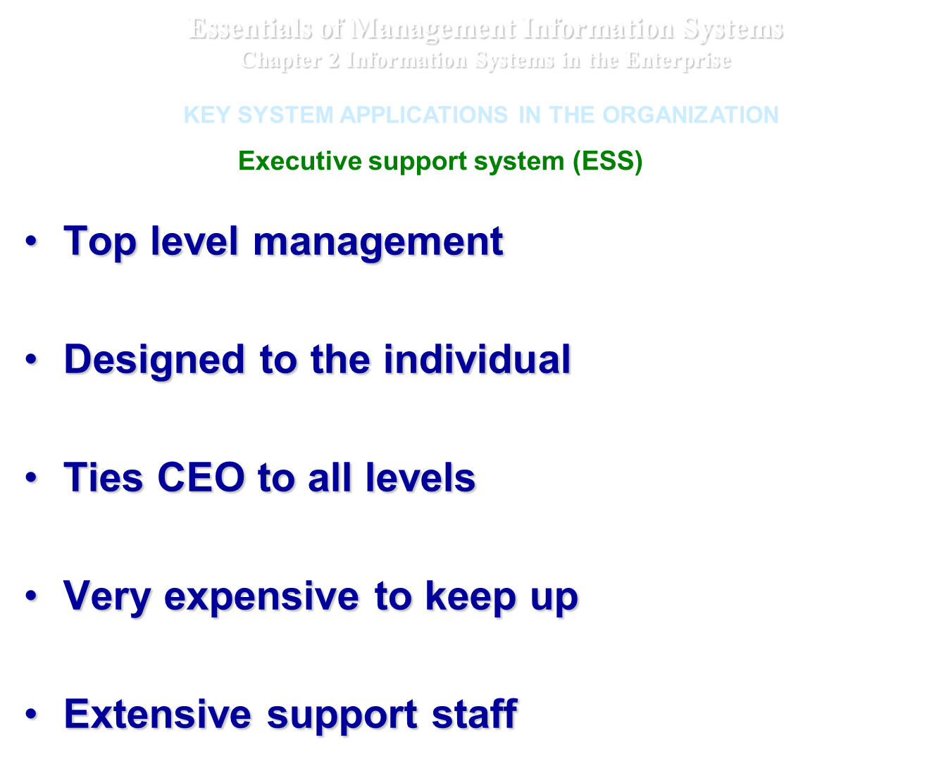

Slide 25
Activities in decision support system
What if analysis
Sensitivity analysis
Goal seeking analysis
Optimization analysis

Slide 26
VOYAGE-ESTIMATING DECISION SUPPORT SYSTEM
Ship file eg speed,capacity
PC
Port distance
Restriction file
fuel consumption cost file
Ship charter hire history cost file
Analytical
Models
database
Port expense file
Online
queries

Slide 27
DSS:Example
Voyage estimating system calculates financial and technical voyage details. It is based on analytical models.
Financial calculations include :
  ship/time costs(fuel, labor, capital) ,freight rates for various types of cargo and port expenses
Technical details include factor as:
  ship cargo capacity, speed ,port distances ,fuel and water consumption and loading patterns ( locations of cargo for different ports

Slide 28
Continued…
The system can answer questions such as:
Given a customer delivery schedule and an offered freight rate, which vessel should be assigned at what rate to maximize profits?
What is the optimal speed at which a particular vessel can optimize its profit and still meet its delivery schedule?
What is the optimal loading pattern for a ship bound for US west coast from Malaysia?

Slide 29
DSS : Intrawest(largest Ski operator in north America
The system is not not model driven , focusing instead on extracting useful information to support decision making from massive quantities of data.
It uses special software to analyze these data to determine the value , revenue potential and loyalty of each customer so managers can make better decisions on how to target their marketing programs
The system segments the customers into categories from “passionate experts” to “ value – minded family vacationers “ etc
The company then emails video clips that would appeal to each segment to encourage more visits to its resort

Slide 30
4) EXECUTIVE SUPPORT SYSTEMS FOR SENIOR MANAGEMENT
Issues at senior Management level:
  What will employment be in 5 yrs ?
  What are long term industry cost trends , where does our firm fit in?
  What products should we be making in next 5 yrs?
  What new acquisitions would protect us from cyclical business swings ?

Slide 31
Characteristics of ESS
Are tailored to individual executives
Are easy to Use
Have drill down abilities
Support the need for the external data
Can help with situations that have high degree of uncertainty
Have a future orientation
Are linked with value added business processes

Slide 32
Role of ESS
Addresses non routine decision requiring judgement , evaluation, and insight
Presents graphs and data from many sources through an interface that is easy for senior managers to use
Incorporates data about external events such as new tax laws or competitors ,but also draws a summarized information from internal MIS and DSS
It filters ,compresses and track critical data , displaying that data of greatest importance to senior managers.

Slide 33
MODEL OF AN EXECUTIVE SUPPORT SYSTEM
ESS
Workstation/Portal
Menus
Graphics
Communications
Digital Dashboards
ESS
Workstation/Portal
ESS
Workstation/Portal
Internal data External data
TPS/MIS data Dow Jones
Financial data Internet news feeds
Office systems Standard & Poor
Modelling/analysis
Menus
Graphics
Communications
Digital Dashboards
Menus
Graphics
Communications
Digital Dashboards

Slide 34
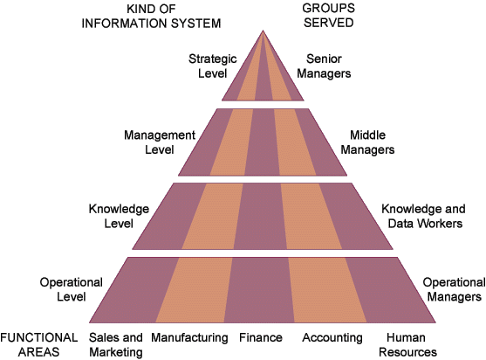
Essentials of Management Information Systems
Chapter 2 Information Systems in the Enterprise
KEY SYSTEM APPLICATIONS IN THE ORGANIZATION
Types of Information Systems
Figure 2-1

Slide 35
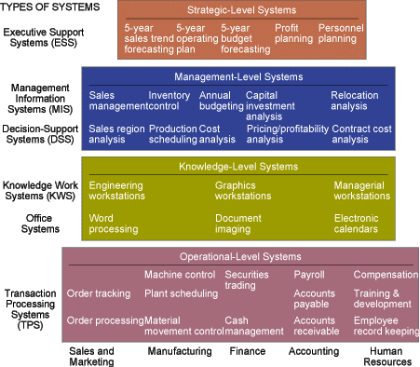
Essentials of Management Information Systems
Chapter 2 Information Systems in the Enterprise
TYPES OF INFORMATION SYSTEMS
Figure 2-2

Slide 36
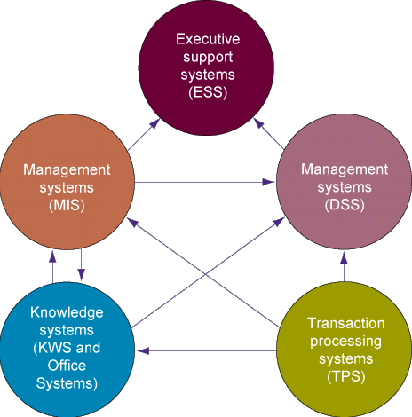
Essentials of Management Information Systems
Chapter 2 Information Systems in the Enterprise
INTERRELATIONSHIPS AMONG SYSTEMS
Figure 2-9

Slide 37
